Slide 1


What’s Good – Item Recommendation System
General Assembly – DAT 10
Presented by: Tom Harel – Data Scientist @ EAT24

Slide 2
Agenda
About EAT24
A Little About EAT24 and our Business
Facing one of our Biggest Problems
Thinking About our Clients
Recommendation Systems @ EAT24
What’s Good
Recommendation Systems in a Sentence
GA Final Project
Wrap Up
Q&A

Slide 3

About
*Almost all of the quirky images and movies in this presentation are from the EAT24’s blog – the Bacon Sriracha Unicorn Diaries
(URL: http://blog.eat24.com/)

Slide 4
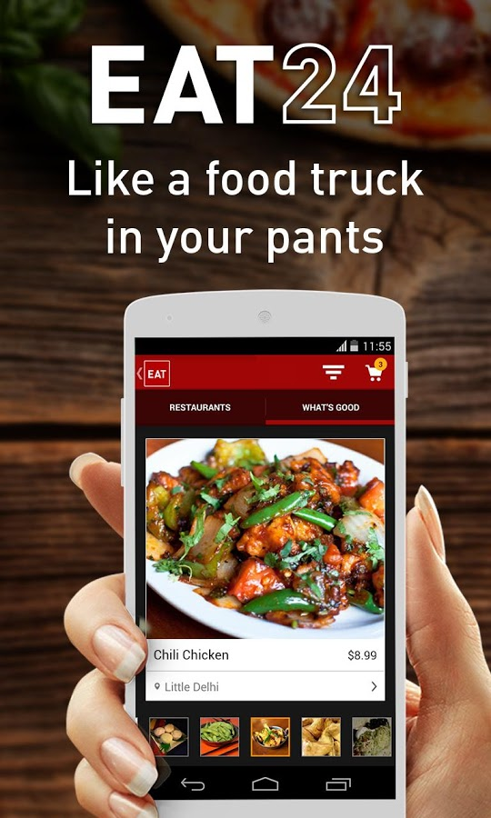
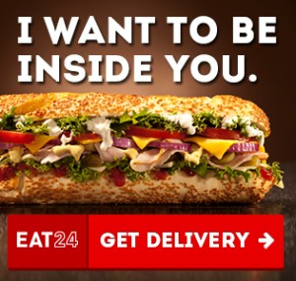

in a Nutshell
Food Delivery Network
Over 25,000 restaurants in 1,500+ cities.
Live chat, email and phone support 24/7.
A service that's 100% free and insanely intuitive to use.

Slide 5

in 30 Seconds
Source: https://www.youtube.com/watch?v=8dagBE7s8FU
Notes:
First lets look at the ordering process from the search -> rest. List -> menu -> checkout
https://www.youtube.com/watch?v=8dagBE7s8FU

Slide 6

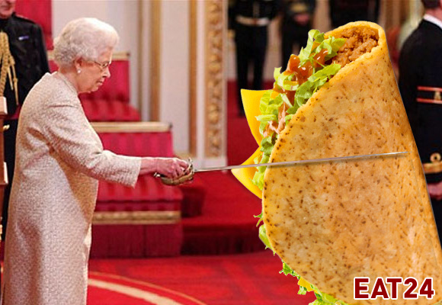
Facing One of our Biggest Problems
Client Enters Address to Search
Restaurant List
Restaurant Menu (Items)
Checkout
Simplified Ordering Process:
Notes:
First lets look at the ordering process from the search -> rest. List -> menu -> checkout
Our problem is with the restaurant list page -> as you will see in the next slide.
Also, look out for mystery step @ end of order.

Slide 7
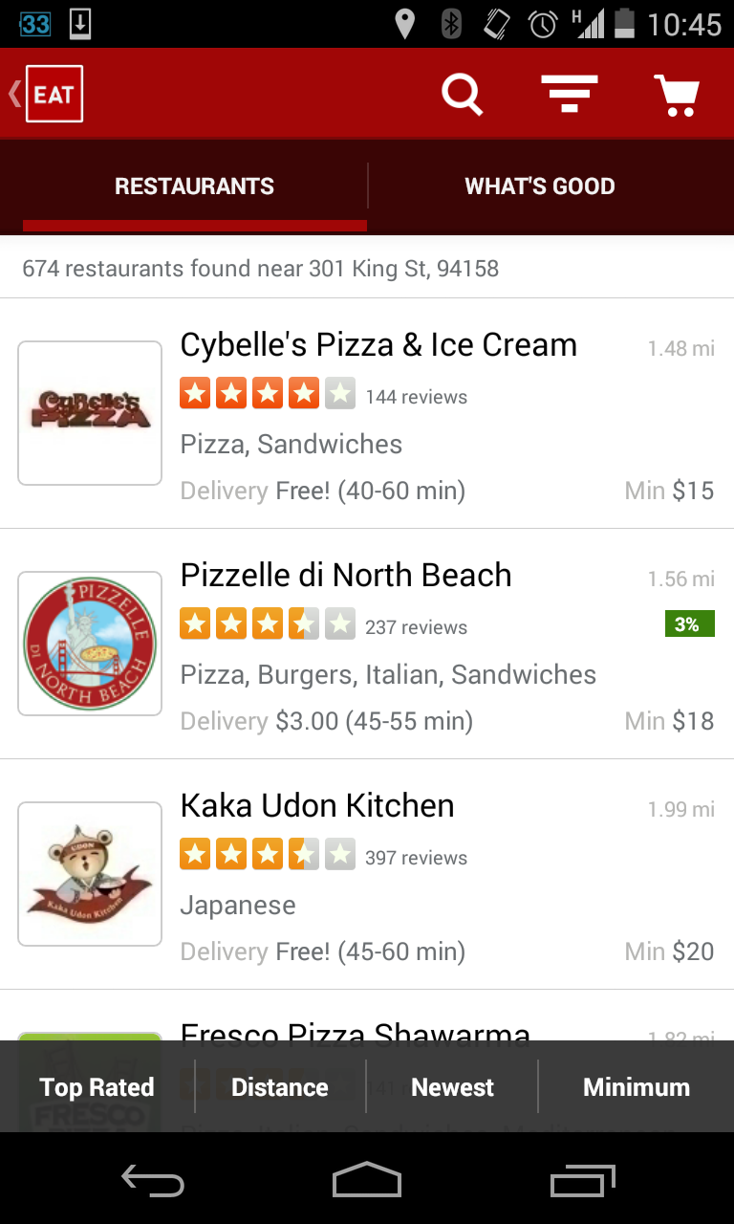

Facing One of our Biggest Problems
The Problem:
The Restaurant List has the highest bounce rate of all process steps.
Although we have a variety of filters (e.g. cuisine, distance, Yelp rating), in highly dense areas there is still a large number of restaurants to choose from (over information problem).
Notes:
-- How many can go over 674 restaurants? How many think they can go over 10?
-- Possible Solutions:
* Improve restaurant list design and user experience (e.g. add more filters) => we have done a lot of modification and improvement on the rest list. There’s not much more to do.
* Show the client a sorted restaurant list (personalized or general) => we have done a general sort + basic personalization – results were good, but bounce rates are still high.
* Skip the restaurant list and present the client with items they are likely to enjoy.

Slide 8

Let’s take a quick break to think about our clientele…
Source: https://www.youtube.com/watch?v=6CoSU726nDE
Notes:
Considering the possible solutions, it might be beneficial to think about our clientele….
OUR CLIENTS ARE LAZY!

Slide 9
Recommendation Systems @

Slide 10
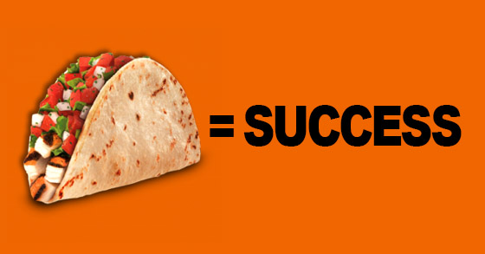
What’s Good
We acknowledged the problem of drop rates in the Restaurant List section, and decided to pursue a new product that will allow clients to directly interact with the best dishes around them, avoiding the previous requirement of choosing the restaurant first.
Also, we wanted to help our clients, who deal with one of the most difficult questions man has ever pondered – “What am I gonna eat tonight?”. Everyone has felt the frustration of not knowing what they REALLY want.
That’s why we spent a lot of time on research and design and came up with What’s Good, earlier this year.
Notes:
Maybe talk a little about the what am I gonna eat tonight? If I show you pictures of food – and you see something you like -> would that trigger something? We believe (and shown) it does.

Slide 11
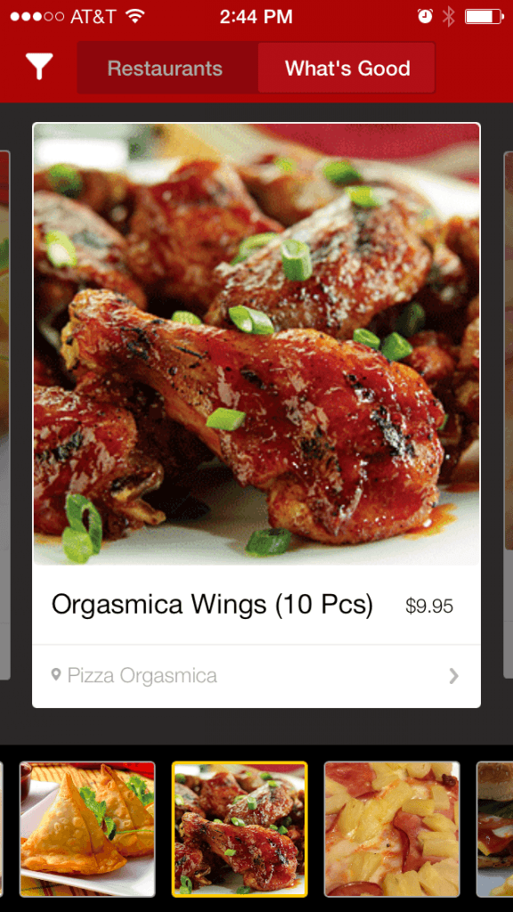
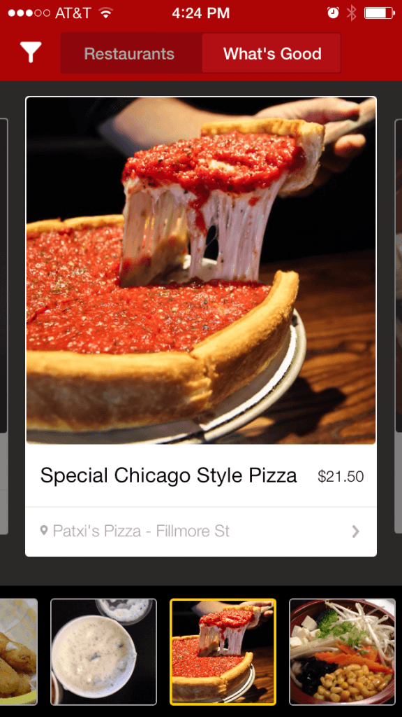
What’s Good
Notes:
Current design and UI of what’s good on iPhone

Slide 12
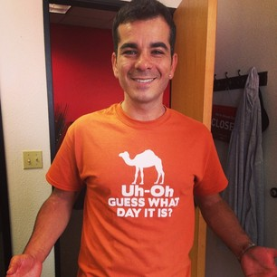
What’s Good
This feature has proven itself to be likeable amongst users and to have good conversion rates, comparable to our normal ordering flow.
But, we can do better! Our current algorithm is very limited and does a lot of aggregations.
Hence we want to venture into Personalized Recommendation Systems…
Notes:
Co-founder…

Slide 13
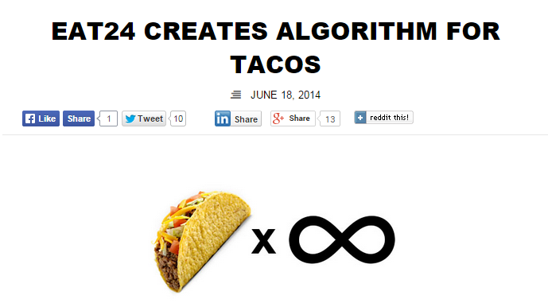

Recommendation Systems
Generally speaking, the goal of the recommendation system is to estimate the rating a user will give an item they have not rated before.
This is accomplished by using previous client-item interactions (such as purchases, explicit rating, etc.) and some sort of fancy mathematical model.
…
Source: http://blog.eat24hours.com/eat24-creates-algorithm-tacos/
Notes:
Initial algo exists since June but it isn’t all that great….

Slide 14

GA Final Project Specifics

Slide 15
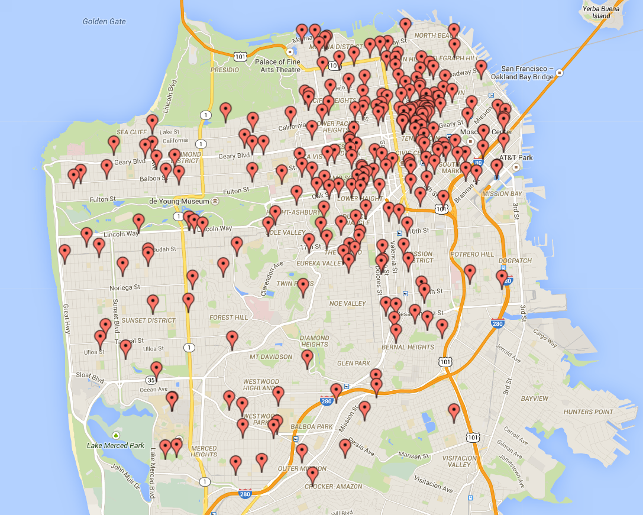
GA Final Project – SF Sample
For this project I took a random sample of EAT24’s top San Francisco clients’ order history in the last 6 months.
The sample includes a total of 250 clients and 14,429 items.
Sample Client Locations
Notes:
A top client is a client with > 50 orders in a desired timeframe.
Notice that the mass of users is around downtown (expected), so we might expect recommendations from this model to be better around the mass of users (due to delivery segmentation) than in the far west of the city.

Slide 16

GA Final Project – Data
We keep track of our users (not in the creepy way) and know a lot of user-item interactions. The most important of which is, of course, purchase. Other interactions we track are views, comments, explicit (binary) rating, and textual feedback.
For the purposes of this project I will use only purchases for the user-item interactions, such that my observed dataset is a sparse matrix of clients and items, filled with binary elements. Something like:
User / Item | i1 | i2 | i3 | i4
u1 | 1 | 0 | 0 | 1
u2 | 1 | 1 | 0 | 0
u3 | 0 | 0 | 1 | 1
Notes:
Note that the items are segmented. That is a client from SF can’t really buy and item from NY…

Slide 17





Simple Model Flow Chart
Database
Data Manipulation and Model Training
Web Server
Build Predictions
Clients
Notes:
1. Collect data in DB
2. Data manipulation is to clean the data and segment the different markets.
3. Build predictions for users in relevant markets
4. Loop every night
-- Clients interact with web server that interacts with the rest

Slide 18

Model Selection
The model of choice for this problem is Model-based Collaborative Filtering.
Reasoning:
We have lots of clients in many (segmented) markets (making the client-item interaction matrix a wide matrix, i.e. more items than clients).
Our clients interact with a limited amount of items, ruling out Item-based CF.
Items don’t map to a very clear feature space, making content-based filtering difficult.
That’s what Snoop said.
(Yes – we asked him.)
Notes:
Markets are segmented. Clients from NY do not interact with clients from LA.
Asaf – co founder and Snoop.

Slide 19
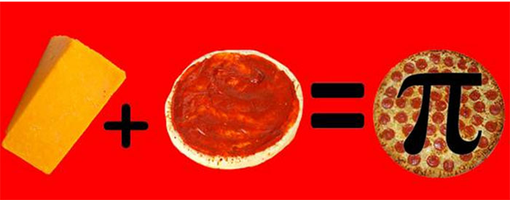

Model Basics
Let:
$R_{nxm}=$ Client-Item Matrix (‘n’ clients and ‘m’ items)
$P_{nxf}=$ Client-Feautre matrix (‘n’ clients and ‘f’ features)
$Q_{mxf}=$ Item-Feature matrix (‘m’ items and ‘f’ features)
i, j, k = indices for clients, items and features, respectively.
Goal:
Decompose $R_{nxm} ≈P_{nxf} ∙ {{(Q}^{T})}_{fxm}$
We want to minimize the sum of squared errors with regularization:
$$arg\min_{p, q}{\sum_{ui∈obs}{{(r_{ui}−p_{u}q_{i}^{T})}^{2}}+ β( \sum_{u}{{\left|p_{u}\right|}^{2}}+\sum_{i}{{\left|q_{i}\right|}^{2}} )}$$
VS
p_{u} and q_{i} are user-feature and item-feature vectors, respectively.
Notes:
Remind folks lower case letters here are vectors and uppercase letters are matrices.

Slide 20


Methodology (ALS)
I will use Alternating Least Squares (ALS) for matrix factorization.
ALS is an iterative method of minimizing the objective function.
After some tedious algebra, I get the update rules:
$p_{u}={(Q^{T}W_{u}Q + βI)}^{−1}Q^{T}W_{u}r_{u}$
$q_{i}={(P^{T}W_{i}P + βI)}^{−1}P^{T}W_{i}r_{i}$
Where:
p_{u} and q_{i} are user-feature and item-feature vectors, respectively. While r_{u} and r_{i} are the purchases/rating vectors for user ‘u’ and item ‘i’ respectively.
W_{i} and W_{u} are diagonal matrices with diagonal elements of the weights for user ‘u’ or item ‘i’.
Mathematical Framework: http://homepage.ntu.edu.tw/~ckuan/pdf/et01/et_Ch4.pdf (see Generalized Least Squares derivation)
Notes:
Talk about the weights.
BORING MATH
http://bugra.github.io/work/notes/2014-04-19/alternating-least-squares-method-for-collaborative-filtering/

Slide 21
Tuning Model Parameters
Our ALS model requires some parameters to be pre-specified.
Those are:
Regularization Parameter (β)
Ideally this should be tuned in with cross-validation. For lack of time and computing power I set β=0.1.
Number of Features/Factors (f)
Much like the regularization parameter, this parameter needs to be evaluated via
cross-validation. This also needs to be evaluated for performance, as increasing the
number of features will increase computation complexity.
My tests have shown that I need at least 20 features to get ok results, but the
extra complexity with 100 features adds only a few seconds per iteration. So I
decided to use 100 features.
Number of Iterations
Like the previous parameter, the number of iterations affects both the accuracy and
the complexity of the model. However, this is relatively easy to tune (see next slide).
Notes:
I use same beta as bugra’s post for movielens data.
For the number of factor mention the nxf and mxf P and Q matrices from before.

Slide 22

Python Implementation
Implementation in Python was not difficult using original code along with Pandas, NumPy and some other modules. It can even by simpler as there are pre-packaged modules that handle recommendations, e.g. recsys.
Bugra has a very good blog post about implementation of ALS in Python. It can be found here:
http://bugra.github.io/work/notes/2014-04-19/alternating-least-squares-method-for-collaborative-filtering/
Model training takes a long time (even for the “tiny” sample dataset). One remediation to this problem was compiling the mathematical calculations to machine code, and thus accelerating the calculation speed.
This can be easily done in Python by using the Numba package.

Slide 23
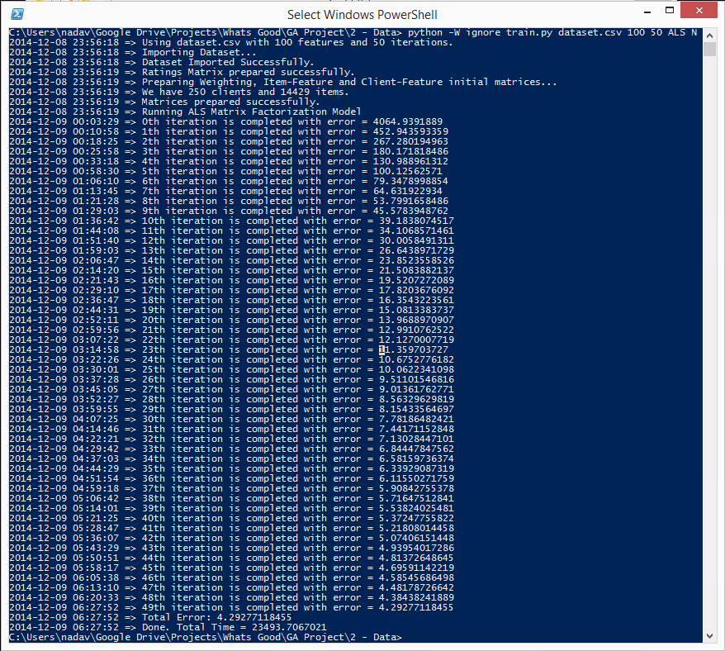
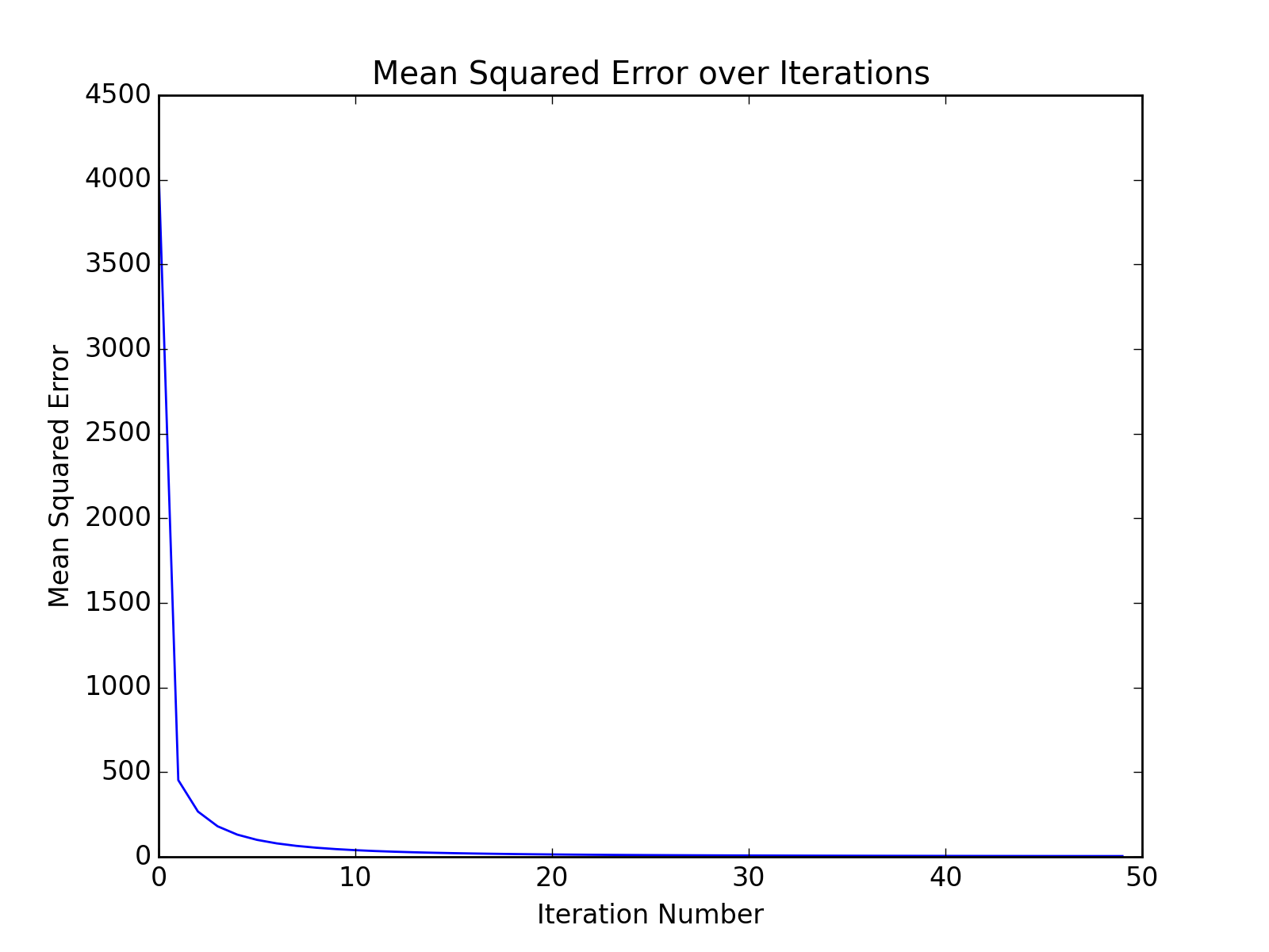
Model Training
Notes:
As iteration goes up, error goes down but complexity goes up.
MSE = 4.293, RMSE = 2.072
Iteration time = 6-7 minutes => we can sacrifice some accuracy for less complexity
Also this is a desktop machine… will be faster on a real server.

Slide 24
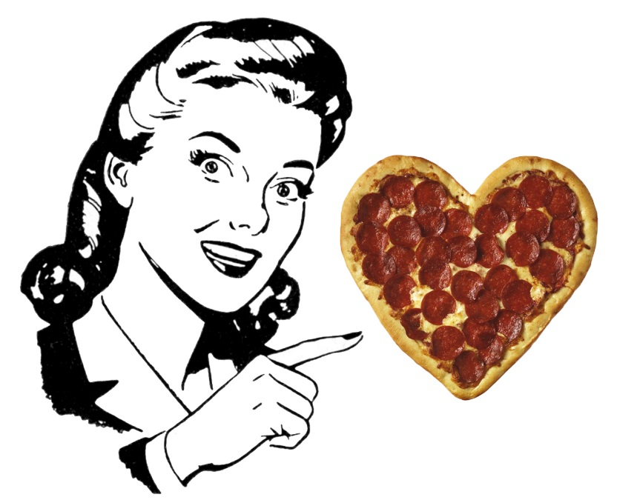
Recommendations
Once the model training is completed, we store the recommendations in a relational database. For this project I used a MySQL database.
In production, we can query the database and fetch the recommendations for the requested user.
Here’s an example of user recommendations from the sample data:
http://www.t0m.xyz/DAT10/recommend/
Notes:
Shooting data to DB for quick query
Show the recommendation web page

Slide 25
Wrap Up

Slide 26
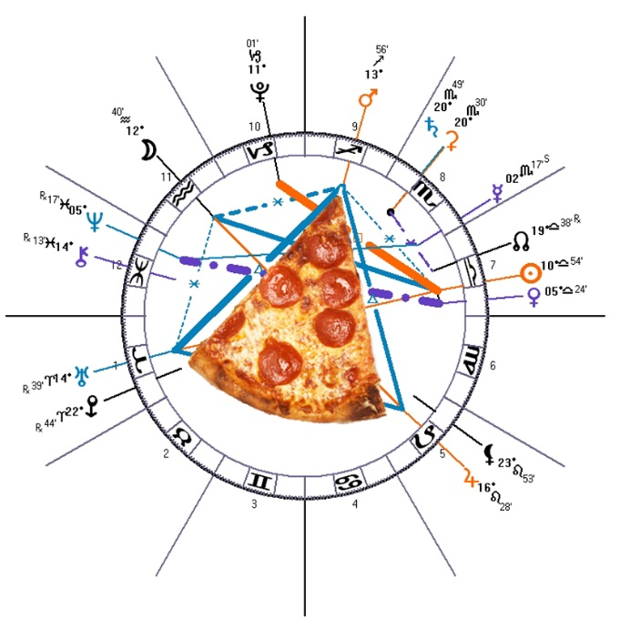
Wrap Up
This project’s goal was to come up with an algorithm for personalized item recommendations.
In this presentation I presented a simplified model for personalized item recommendations. This model is basic and will need to be improved before implementation in production, but it will lay the ground for EAT24’s What’s Good item recommendation system.
This model can be improved by:
Including item- and user-bias terms
Excluding miscellaneous items, e.g. Soda, White Rice, etc.
Parallelization to improve training performance.
Notes:
I use same beta as bugra’s post for movielens data.
For the number of factor mention the nxf and mxf P and Q matrices from before.

Slide 27
Q&A

Slide 28

Thank You!

